Slide 1
THP Web Application Orientation
April 2023

Slide 2
Table of Contents
High-level System Workflow
Signing into the web application
Core Application Functionality
Household Data Release (ESD only)
Transfer Households
My Team & My Assigned Households Lists
Household Member Screening Form
Shared Care Plan
Care Plan Follow-up
Removal from Program
Other Application Features
Register a New Household (ESD only)
Add Household Members

Slide 3
High-level System Workflow

Slide 5
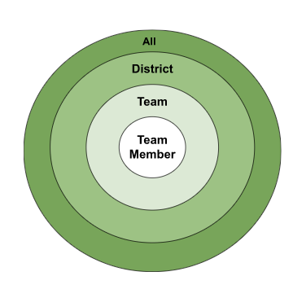
Users & Data Access
Every THP application user is part of a team.
A team facilitates screening and follow up for a subgroup of ~100 households from one or more districts in the State of Vermont.
Team members will only be able to access household information that is part of their team’s district coverage area, except for ESD team members who will be able to access all households.

Slide 6
Iterative App Development
To date, there have been 4 different versions of the application which included varied updates & enhancements based on stakeholder & user input:
Version 1: Release Household Data, Household Transfer, Screening Form
Version 2: Shared Care Plan, Care Plan Follow-Up
Version 3: Refinement of Shared Care Plan, plan summary printing
Version 4: Refinement to Case Lists & Screening Form, Removal from Program form

Slide 7
Signing into the web application

Slide 8
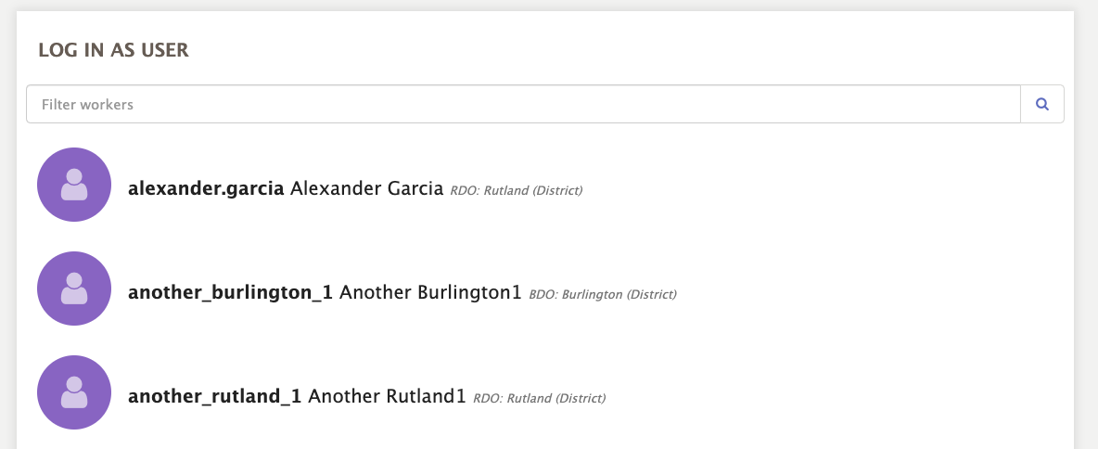
2
1
Select ‘Log in as’ to select your username. Depending on their working location, some users may have more than one usernames to select.
Select the THP Screening Application icon.
This error message will appear if you do not select a username. Close out the error box and complete step 1.

Slide 9
Application Landing Page

Slide 10
Core Application Functionality
Household Data Release (ESD Only)
Transfer Household(s)
My Team & My Assigned Households Lists
Household Member Screening Form
Shared Care Plan
Care Follow-Up
Removal from Program

Slide 11
Household Data Releases [ESD only]

Slide 12
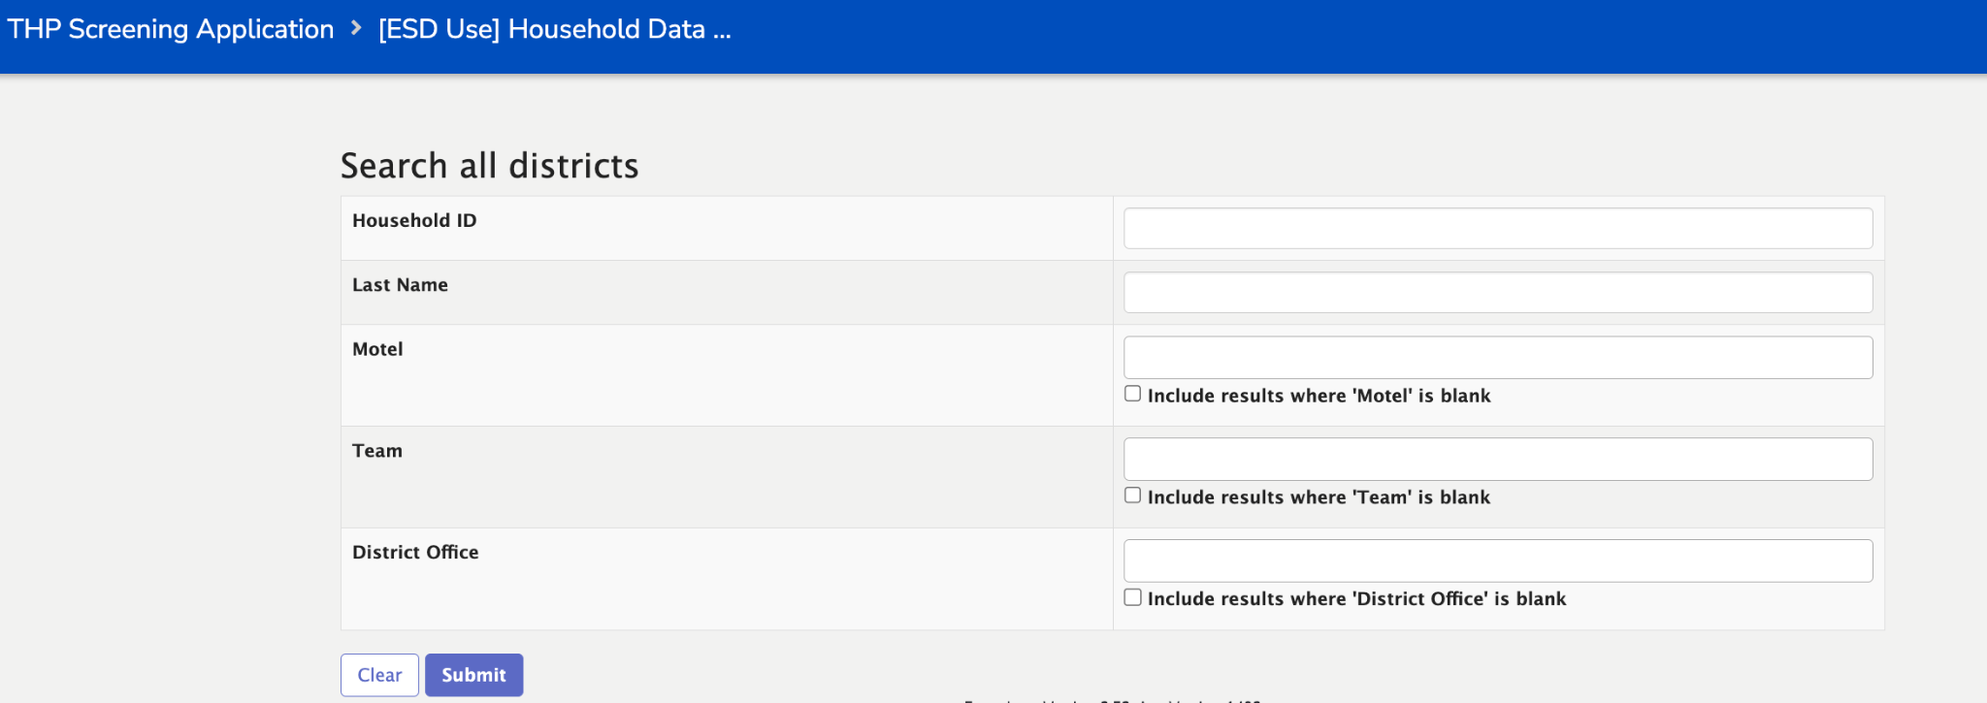
Release Household(s) Data
Only ESD team members can see the [ESD Use] Household Data Releases Module. This module allows ESD team members to view all households across districts, select households that have submitted their consent forms and then update those households' permissions releasing them, giving them the opportunity to be visible by team’s in their district. This module also gives the option to revoke access from team’s in the across districts if this action is deemed necessary.
The search module has search fields that are plain text or multi-select, which allows ESD users to select more than one option from a dropdown. To view all households regardless of search terms you can leave the search fields blank and select Submit to view the entire list.

Slide 13
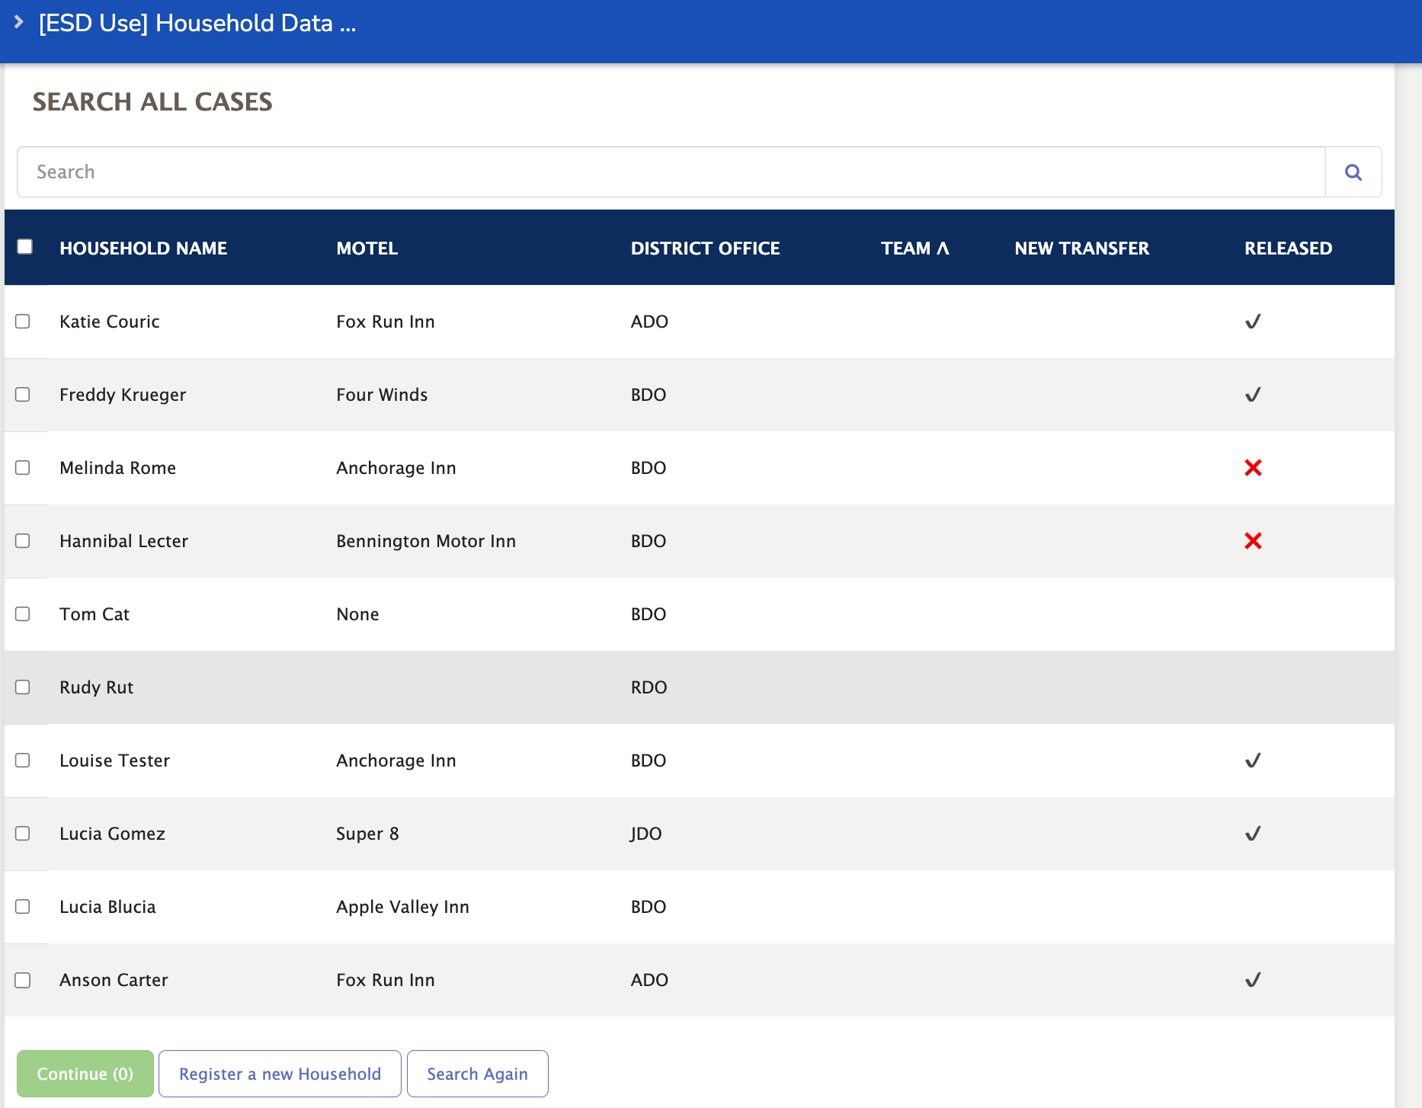
Release Household(s) Data
The search results view includes high-level information about the Households. ESD users are able to see if the Household data has already been released or not, in addition to district & team assignments.
The checkboxes to the far left allow ESD users to select multiple Households to undergo the same action.

Slide 14
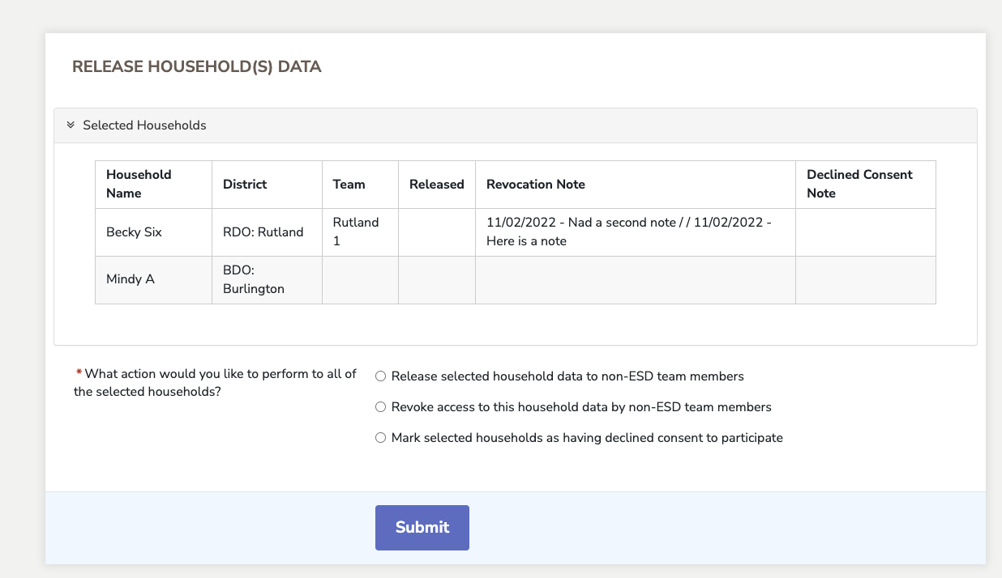
Release Household(s) Data
After selecting the Households to take action on, the form opens and presents options to take.

Slide 15
Transfer Household(s)

Slide 16
Transfer Households
All team members can view the Transfer Households Module from their home screen.
The search module has search fields that are plain text or multi-select, which allows users to select more than one option from a dropdown. To view all households regardless of search terms you can leave the search fields blank and select Submit to view the entire list.

Slide 17
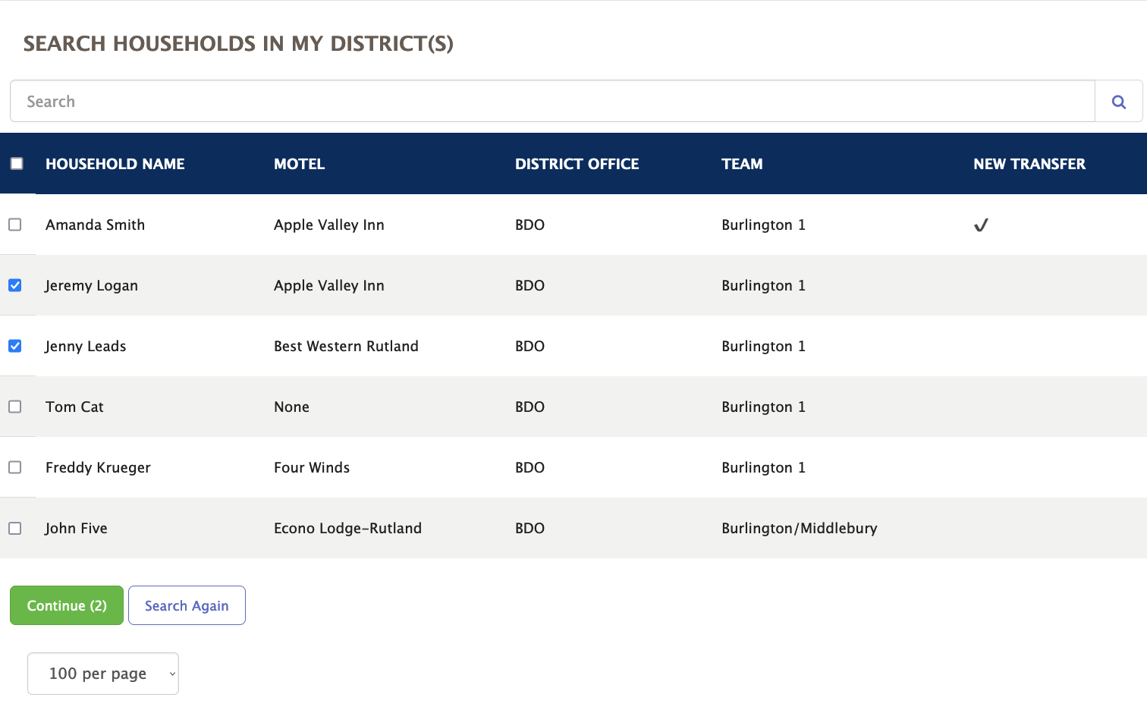
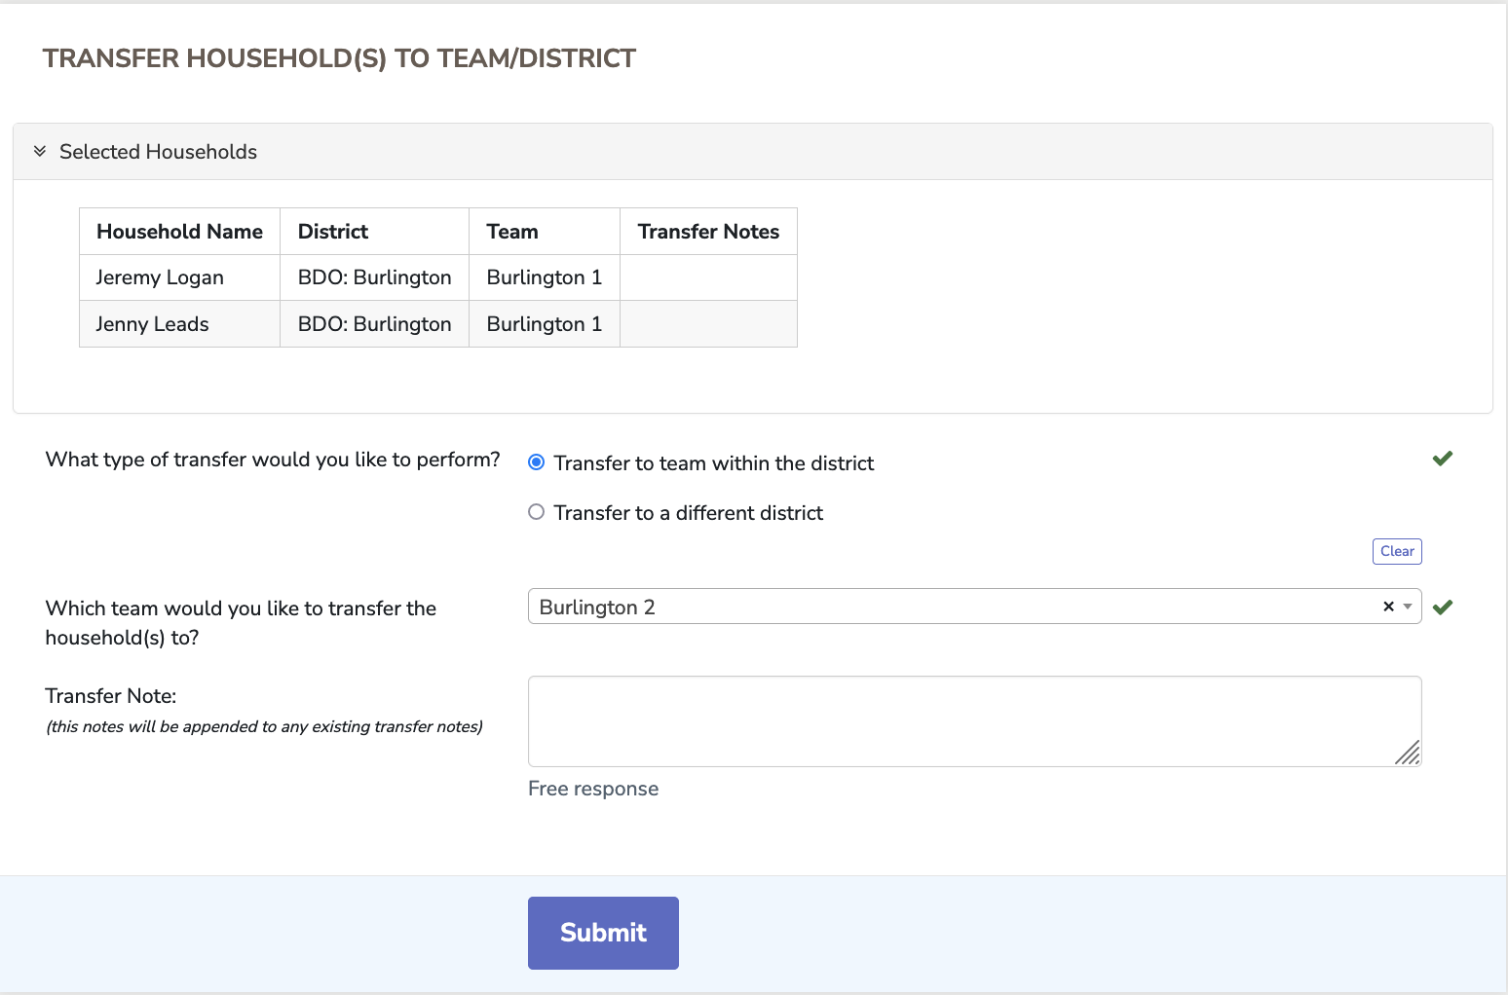
Transfer Households
This module allows team members to view all of the households in their assigned district(s). They can select one or more households and claim them for their team by selecting Transfer to team within district and choosing themselves. They can also transfer to other teams within their district or transfer to a different district entirely.

Slide 18
My Team & My Assigned Households Lists

Slide 19
My Team’s Households
My Assigned Households
The modules My Team’s Households and My Assigned Households lists are identical, except My Team’s Households shows an entire team’s households and household members.
My Assigned Households shows an individual team member’s case load.

Slide 20
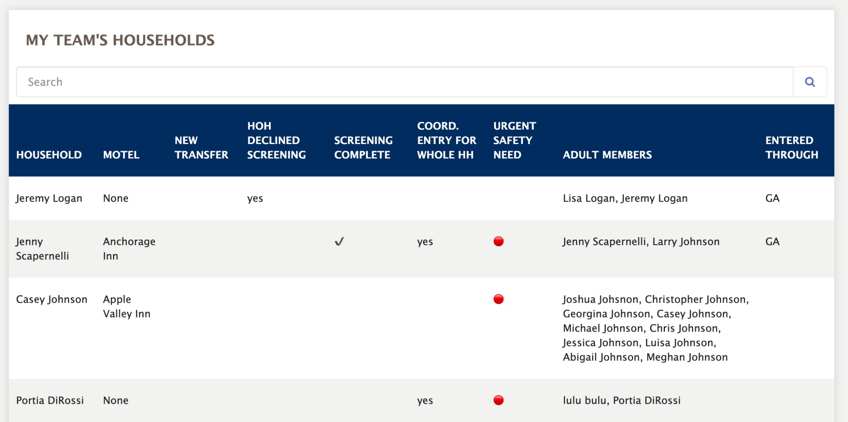
My Team’s Households
Jeremy Logan is the Head of Household

Slide 21
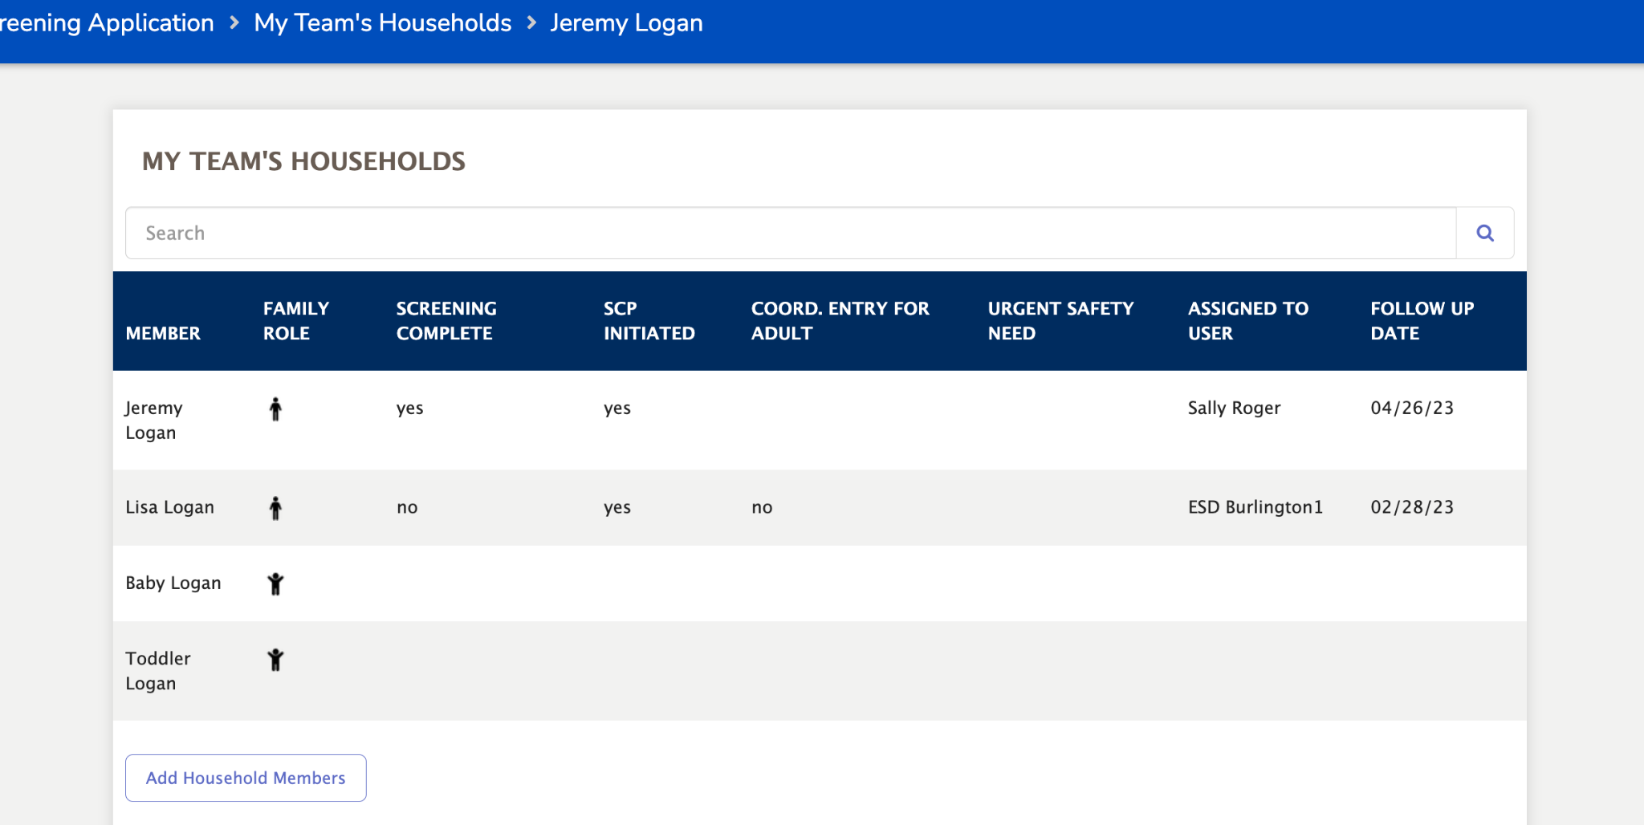
My Team’s Households
There are 4 members of the Logan household (2 adults, 2 children), including Jeremy

Slide 22
After selecting the household member from either list, you will be directed to the 4 main forms of the application

Slide 23
Household Member Screening Form

Slide 24
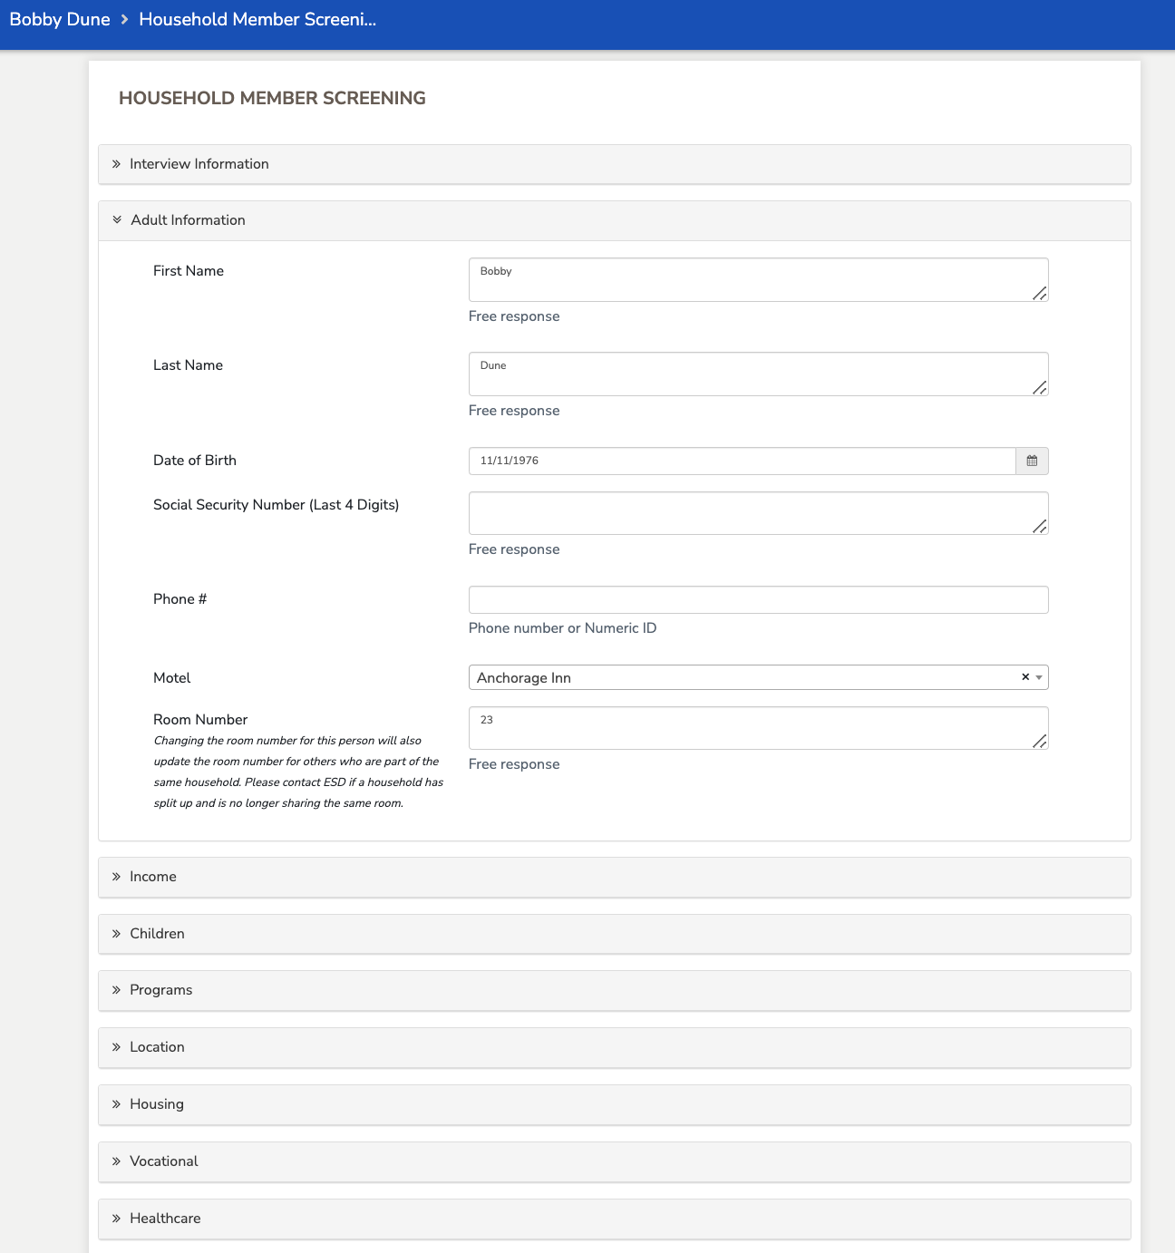
Household Member Screening Form
The Household Member Screening Form top sections will be pre-populated with information from the household registration.
When the team member interviews the family member they must fill in any remaining sections which include: Interview Information, Adult Information, Income, Children, Programs, Location, Housing, Vocational, Healthcare, and Final Details.
These sections are all collapsable for easier form navigation. In the example to the left, all but the Adult Information section is collapsed.

Slide 25
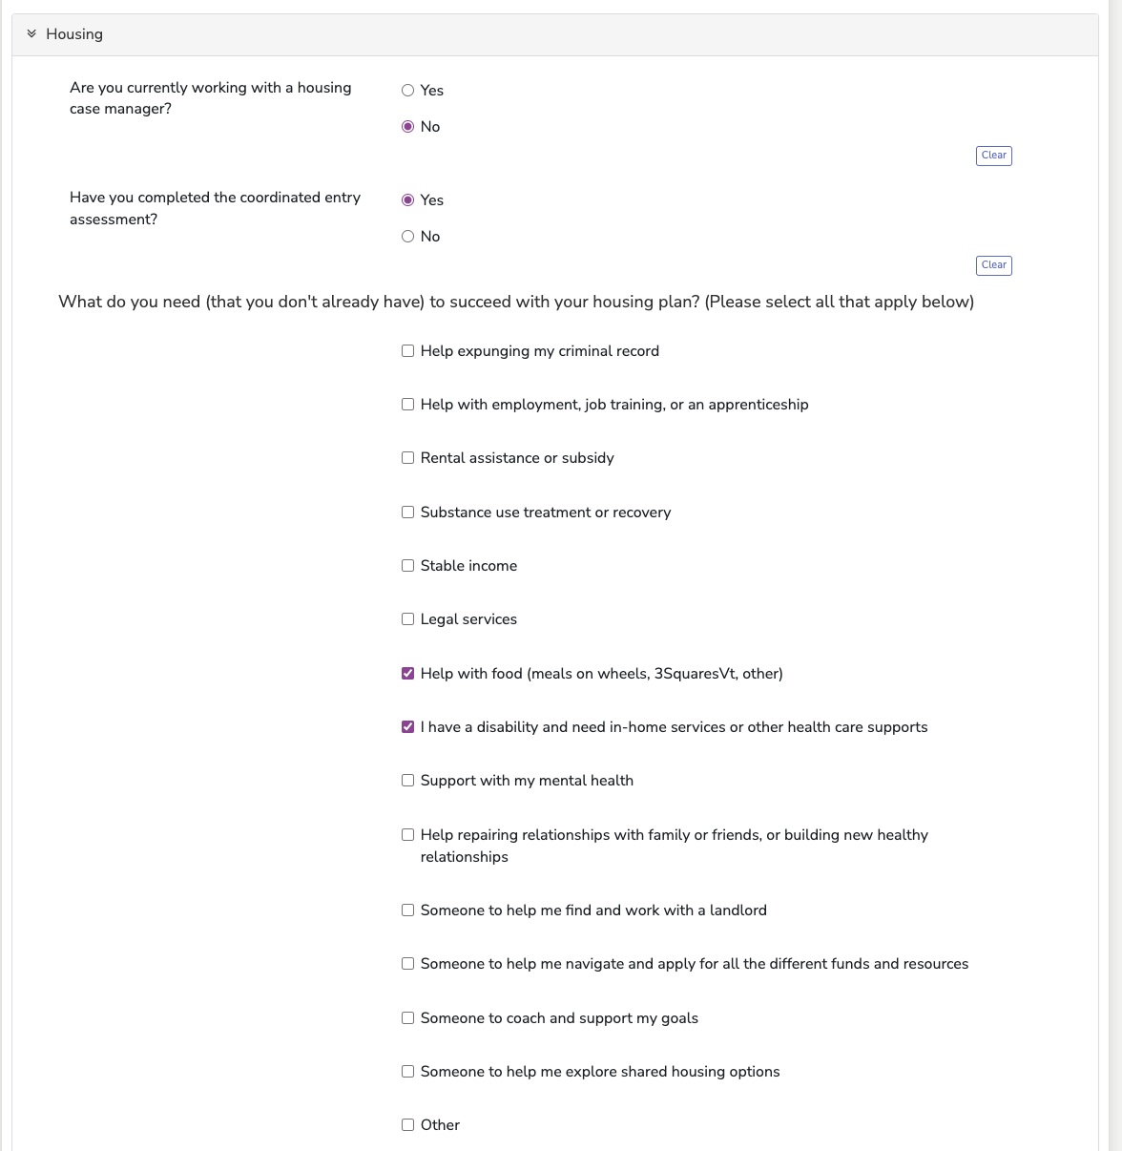
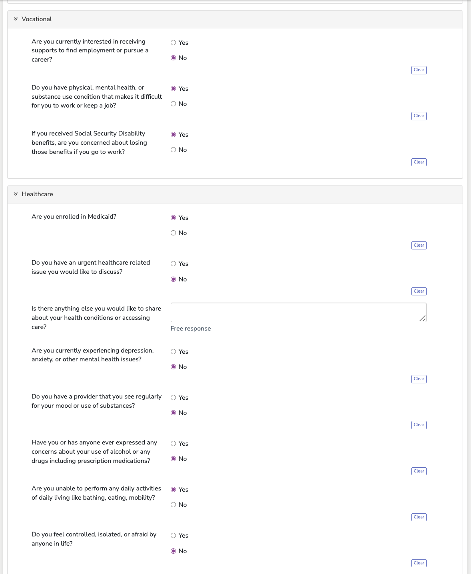
Household Member Screening Form
Various questions trigger the referral and safety indicators that appear later in the Household Member’s Shared Care Plan.

Slide 26
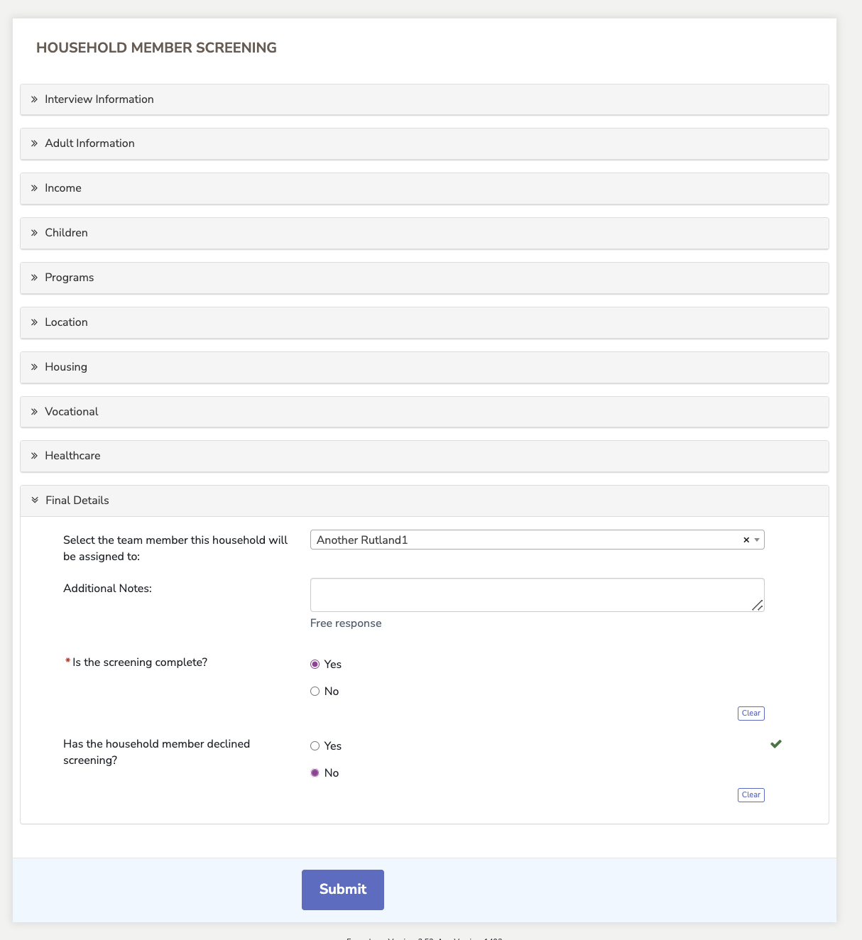
Household Member Screening Form
At the bottom of the form, a team member can assign the household member to anyone on their team.

Slide 27
Shared Care Plan

Slide 28
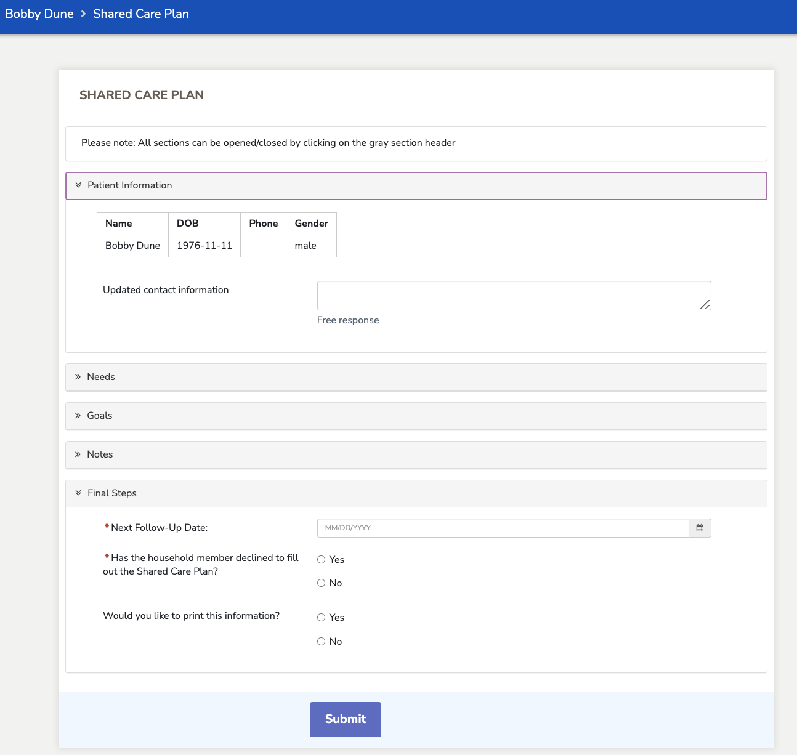
Shared Care Plan
The Shared Care Plan allows an application user to take the information from the Screening Form and turn it into actionable steps that the individual can take to reach their goals and program milestones.
The form has several sections, which can all be collapsed for easier navigation.
An app user can review and add existing Patient and Medical Information, input PCP/Care Coordinator information and add Care Team Members to a Household Member’s file.

Slide 29
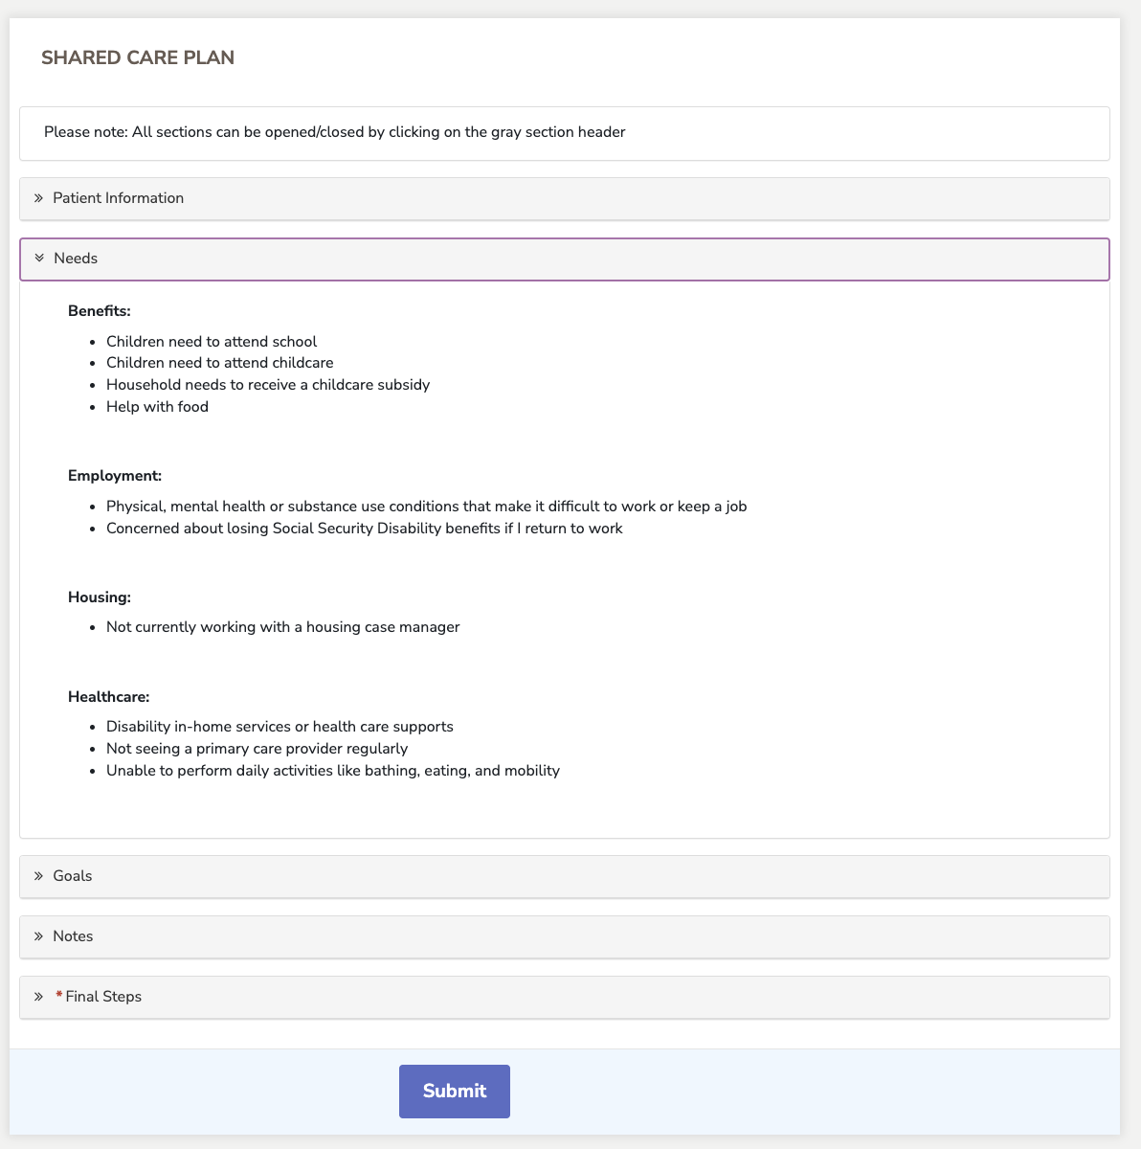
Shared Care Plan
The Needs section of the Shared Care Plan pulls information that was previously entered in the individual’s Household Member Screening Form. The needs are itemized under each service area.

Slide 30
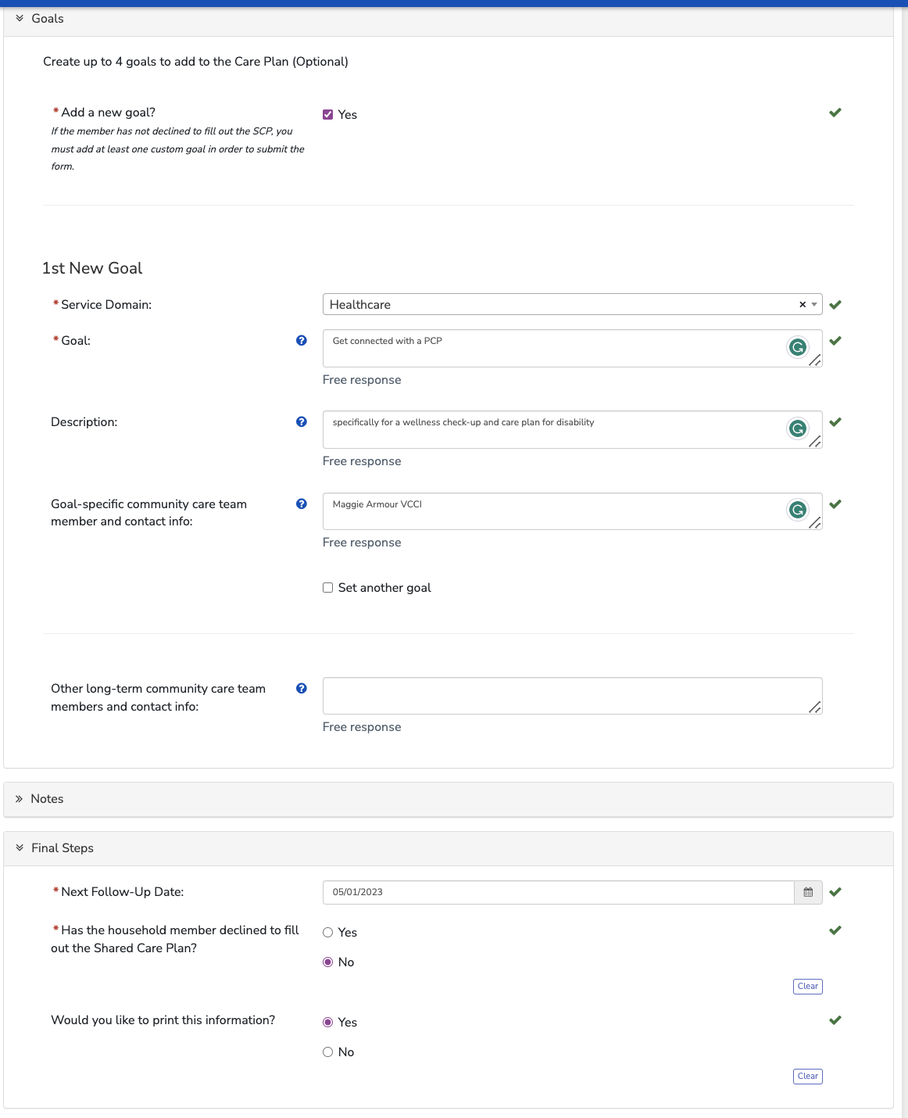
Shared Care Plan
In the Goals section, you can add custom goals informed by conversation with the household member and by reviewing the pre-populated Needs section.
Goals that are set will be pulled through to the Shared Care Plan Follow-Up form.
In the Final Steps section, follow-up date can be set. If you need to share a plan summary with the client, select ‘yes’ to the printing question.

Slide 31
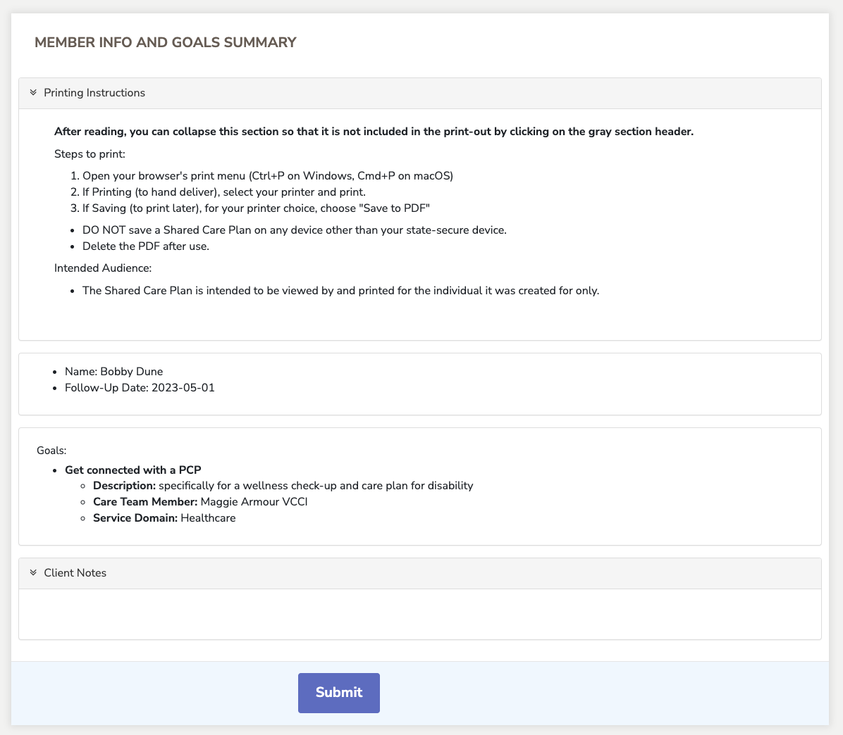
Shared Care Plan
After selecting ‘yes’ for the printing question, you will be directed to a Member Info and Goals Summary page.

Slide 32
Care Plan Follow-Up

Slide 33
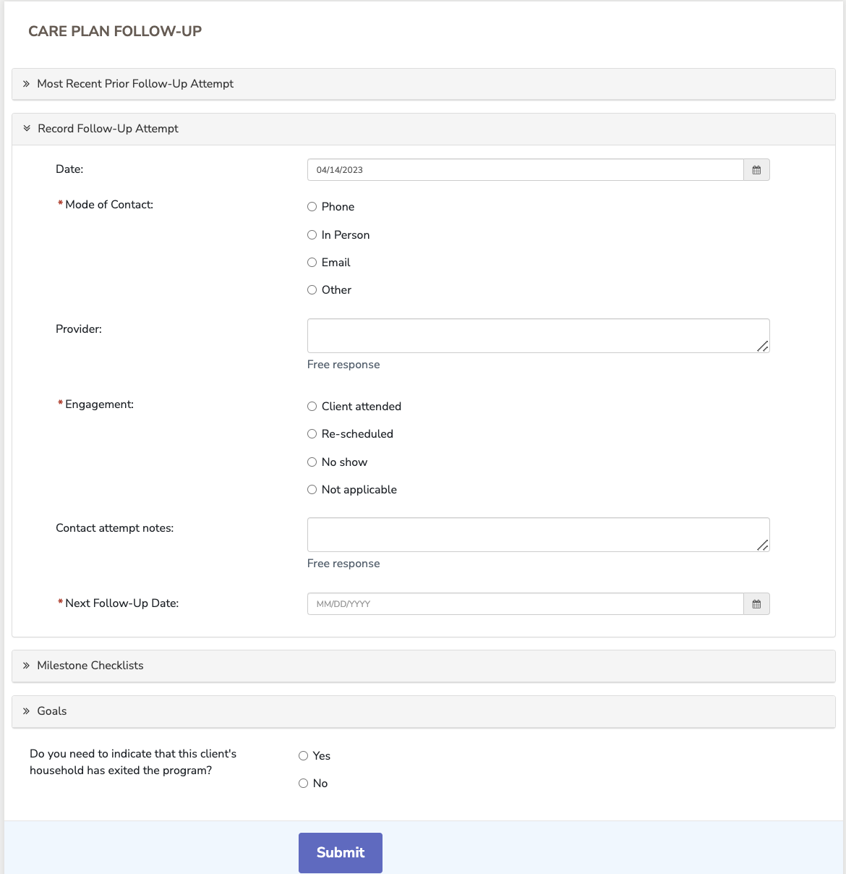
Care Plan Follow-Up
When the Shared Care Plan has been completed, the user can use the information from the Plan to help the individual achieve their goals and check off milestones in the Care Plan Follow-Up form.
At the beginning of the form, the user can register their follow-up attempt, record the mode of contact, engagement, attempt notes and next follow-up date.

Slide 34
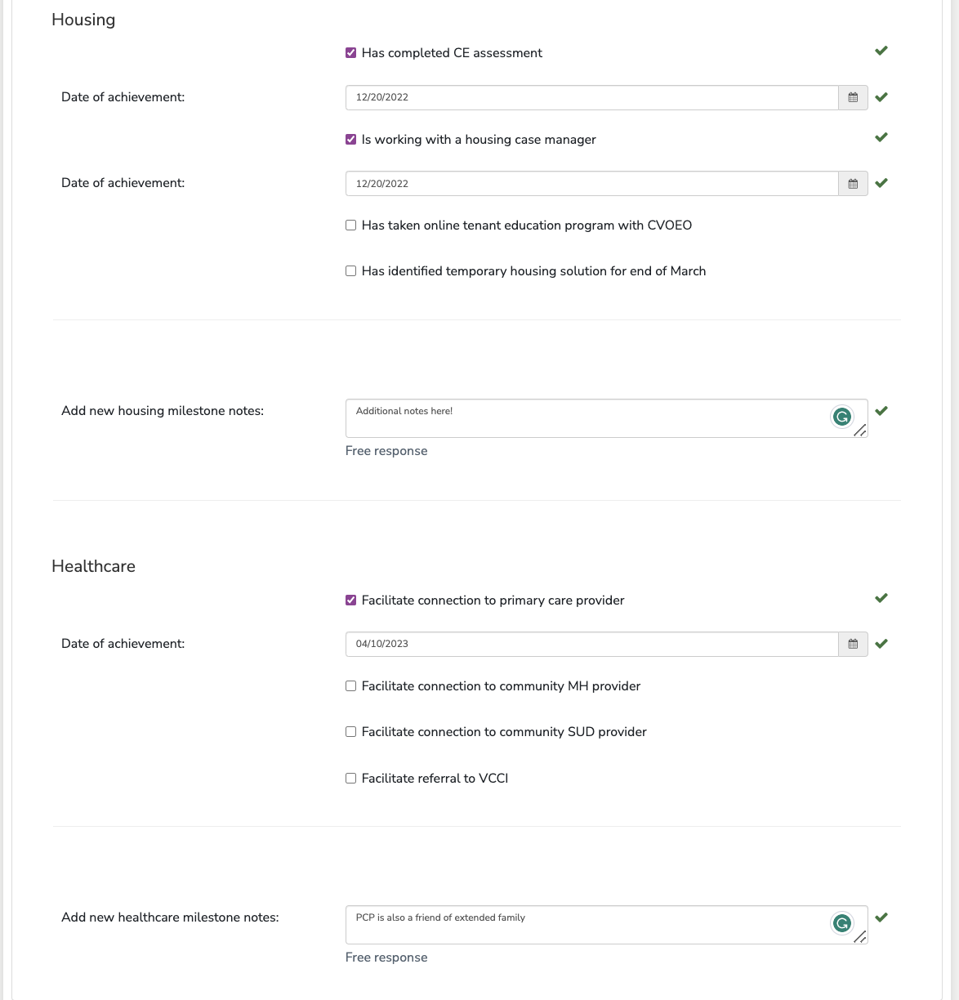
Care Plan Follow-Up
The Milestone Checklists sections based on the agency referrals from the Screening Form. There can be up to 5 for: employment, benefits, housing, healthcare, and urgent safety need.
With each milestone, the user can mark completion, date of achievement, and record notes for the overall section.

Slide 35
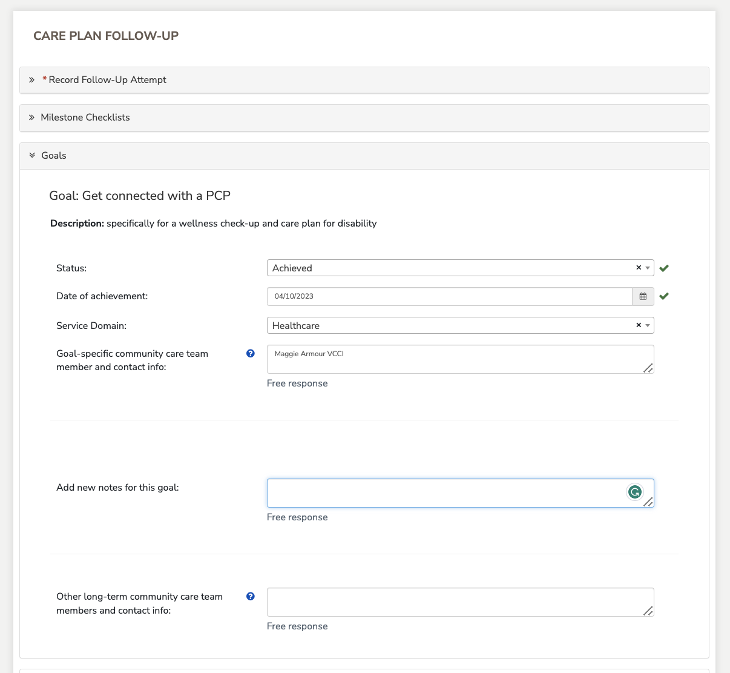
Care Plan Follow-Up
If the client had added personal goals from the Shared Care Plan they will appear in the Follow-Up form with the option to add a status and any additional notes.

Slide 36
Removal from Program

Slide 37
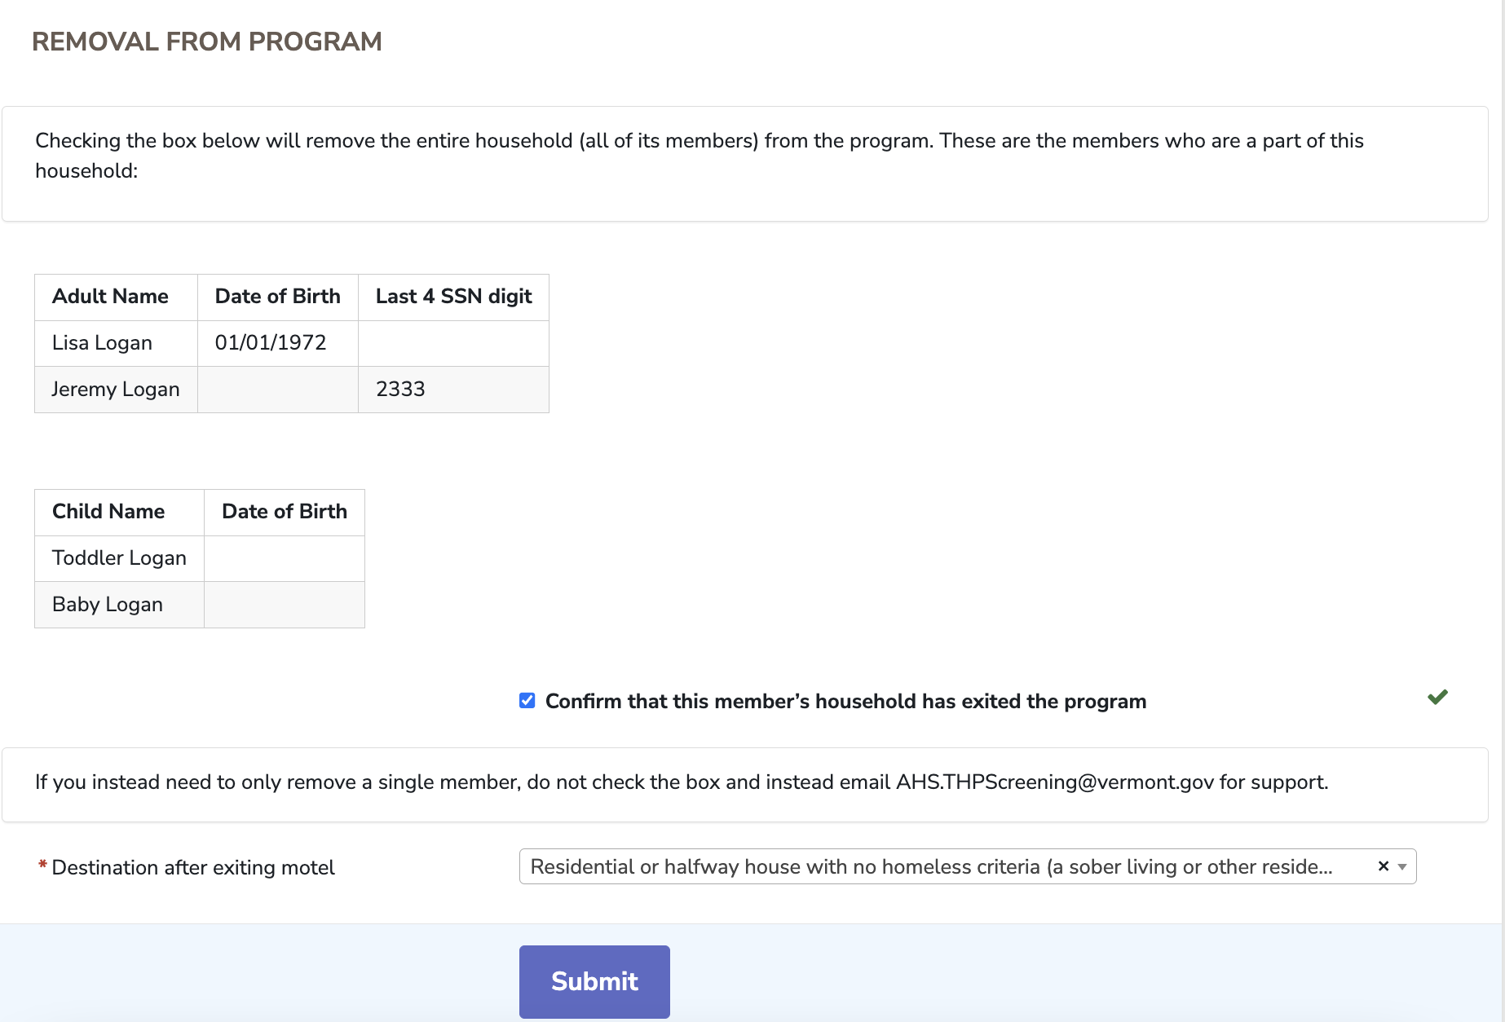
Removal from Program

Slide 38
Other Application Features
Register a New Household (ESD only)
Add Household Members

Slide 39
Register New Household (ESD only)

Slide 40
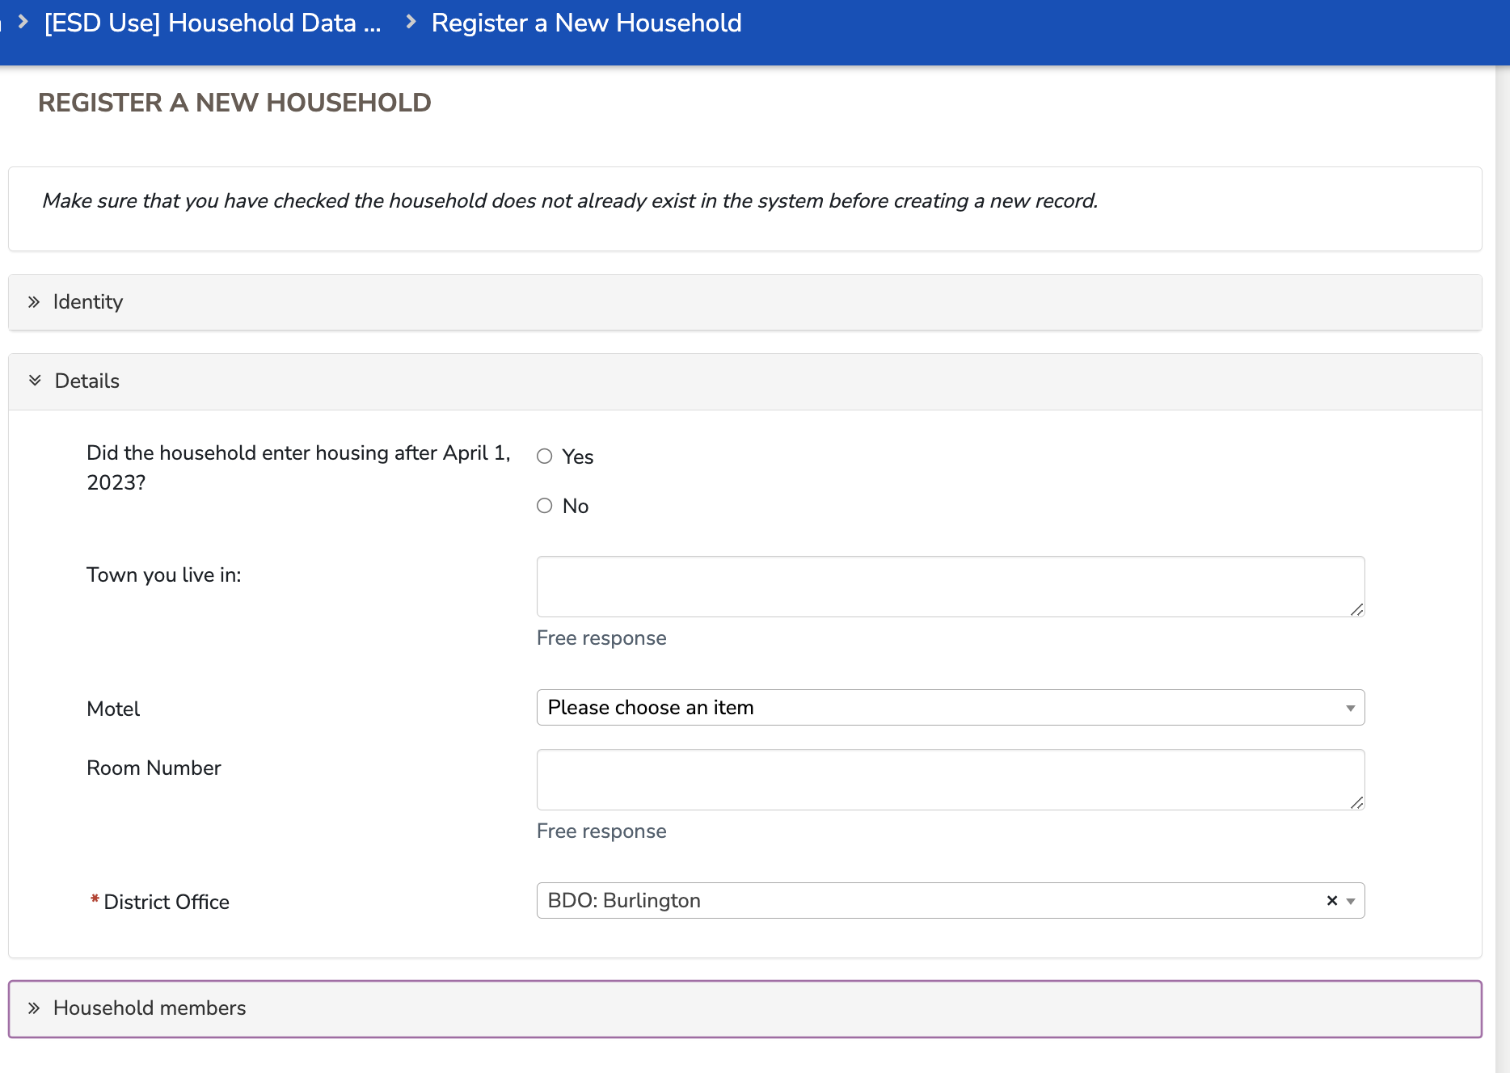
Register New Household (ESD only)
Households are created during a data upload into the CommCare system and additionally, when an ESD team member submits a Register a New Household Form in the web application. The Register a New Household form can be accessed at the bottom of the Release Household Data list.

Slide 41
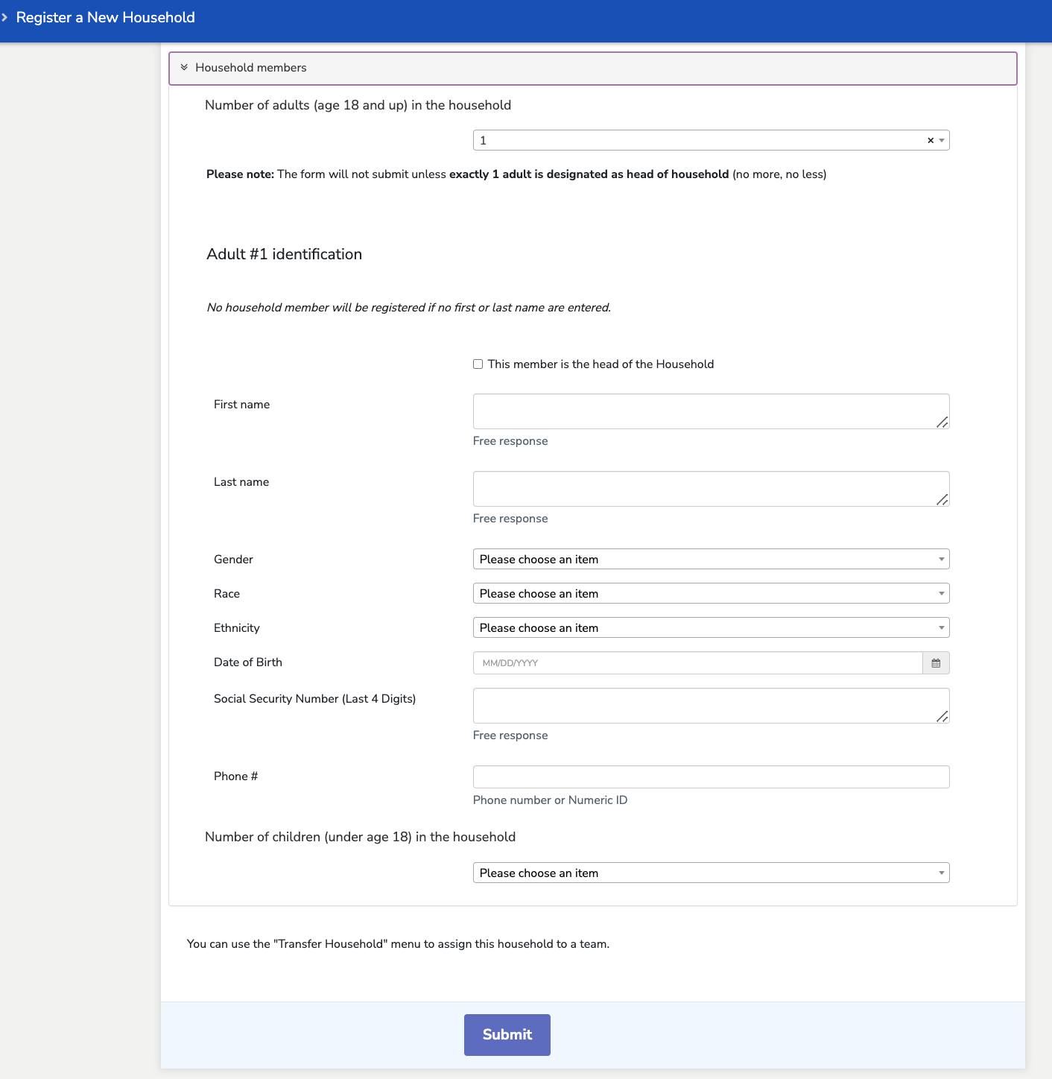
Register New Household (ESD only)

Slide 42
Add Household Members

Slide 43
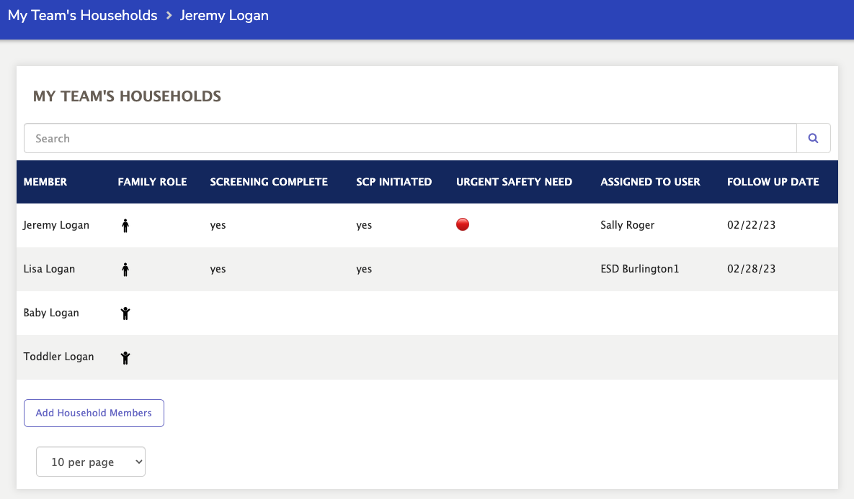
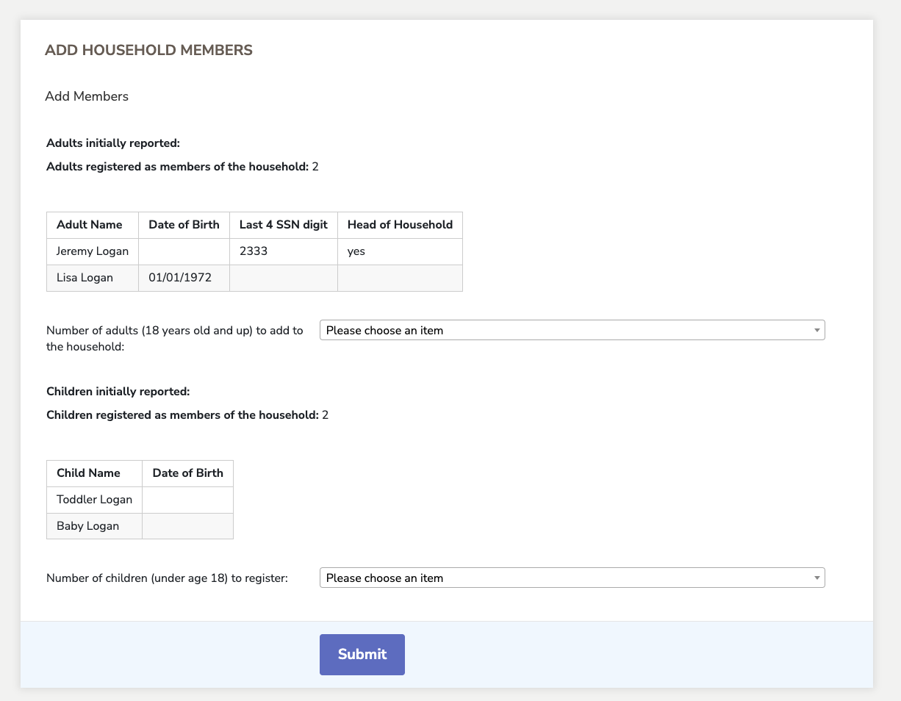
Add Household Members
Household members are created automatically with households. Household members can also be added to a household later in the workflow through the Add Household Members Form. The Add Household Members form can be accessed at the bottom of the Household Member list via My Team’s Households and My Assigned Households list views.

